Slide 1
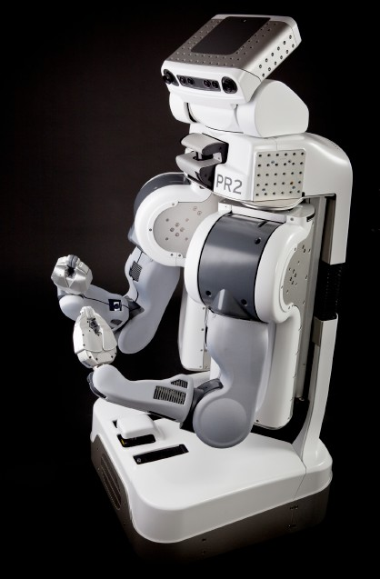
Announcements
Project 5 Ghostbusters
Due tomorrow/Friday 4/15 at 5pm
Homework 9
Released soon, due Tuesday 4/19 at 11:59pm
Cal Day – Robot Learning Lab Open House
Saturday 10am-1pm
3rd floor Sutardja Dai Hall
Robot demos of knot tying, high-fives, fist-pumps, hugs

Slide 2
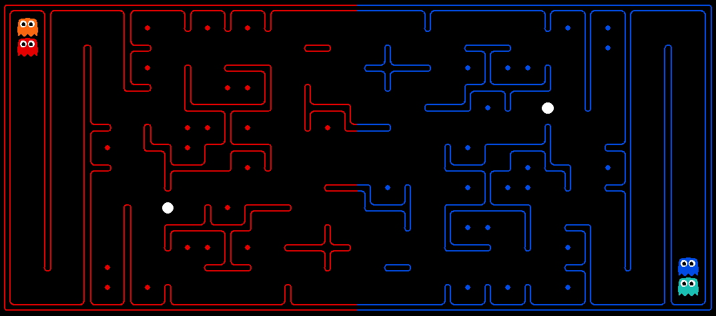
Final Contest!
Challenges: Long term strategy, multiple agents, adversarial utilities, uncertainty about other agents’ positions, plans, etc.

Slide 3
Final Contest Extra Credit
Extra Credit Based on Final Ranking (deadline 4/24 11:59pm)
1st place: 2 points on the final
2nd and 3rd place: 1.5 points on the final
4th to 10th place: 1 point on the final
0.25 points on the final per staff bot beaten in the final ranking.
In addition, every night from 4/17 through 4/24 at 11:59pm we will temporarily close submissions to compute an intermediate ranking, and there is also extra credit:
Top 20: 0.5 points on the final
Top 10: 1 point on the final
Note that the ranking rewards are not cumulative, you will only get points for the highest ranking category you achieve during the contest.

Slide 4
Announcements
Project 6:
Out Thursday assuming all goes well.
HW10: Out today.
Final Contest after Thanksgiving Break
Today: Last “technical” lecture.
Remaining lectures will be applications.
11/17: Vision (Alexei Efros)
11/22: Natural Language Processing (Adam)
11/29: Deep Robotics (Michael)
My office hours this week: Election discussion (and anything else, of course)
Adam’s office hours this week: Deep Learning Frameworks

Slide 5
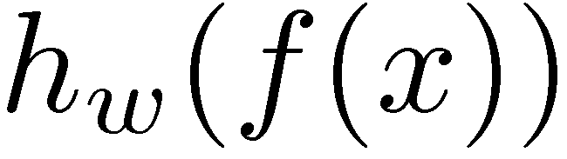
Two-Layer Perceptron Network
w₁₁
Σ
>0?
w₂₁
w₃₁
w₁
f₁
w₁₂
Σ
Σ
w₂₂
>0?
w₂
f₂
>0?
w₃₂
w₃
f₃
w₁₃
Σ
w₂₃
>0?
w₃₃

Slide 6
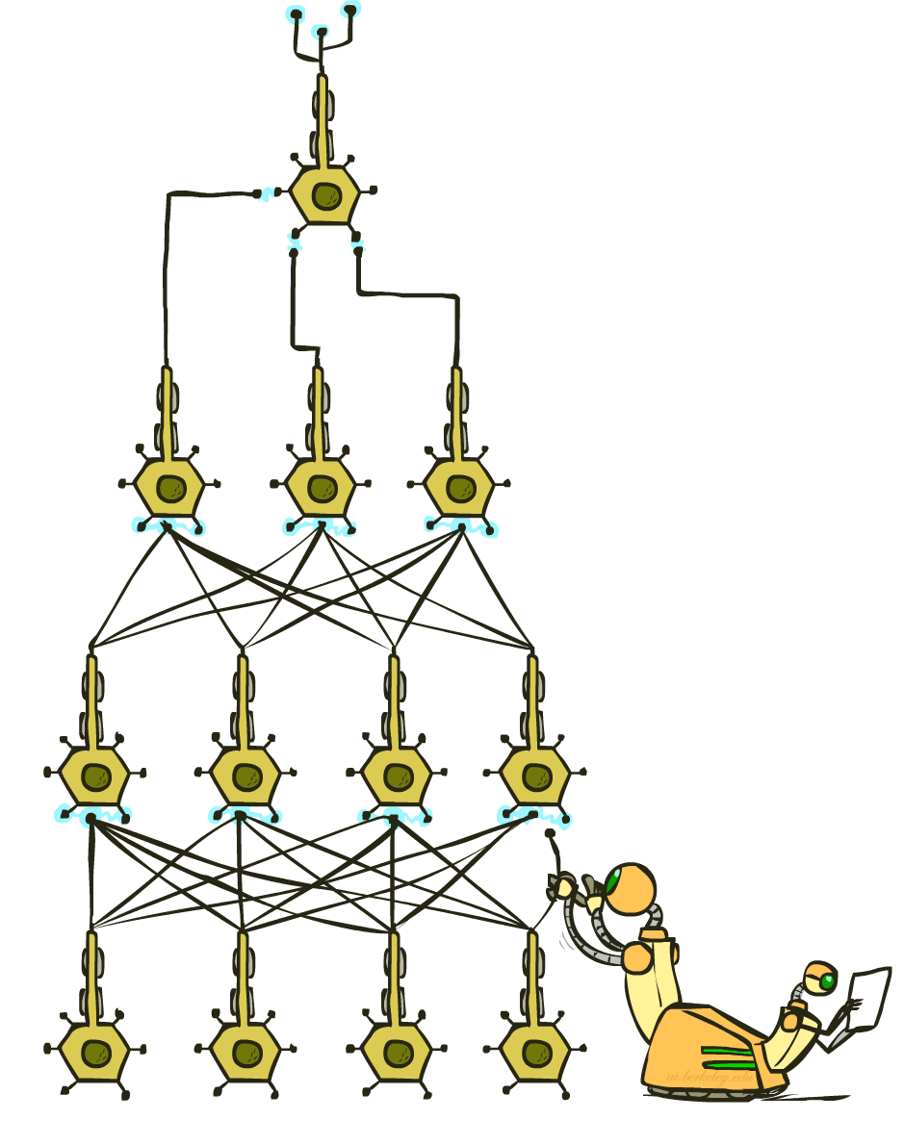
CS 188: Artificial Intelligence
Deep Learning II
Instructors: Adam Janin & Josh Hug --- University of California, Berkeley
[These slides were created by Josh Hug, Dan Klein, Pieter Abbeel, Anca Dragan for CS188 Intro to AI at UC Berkeley. All CS188 materials are available at http://ai.berkeley.edu.]
Notes:
Please retain proper attribution, including the reference to ai.berkeley.edu. Thanks!

Slide 7
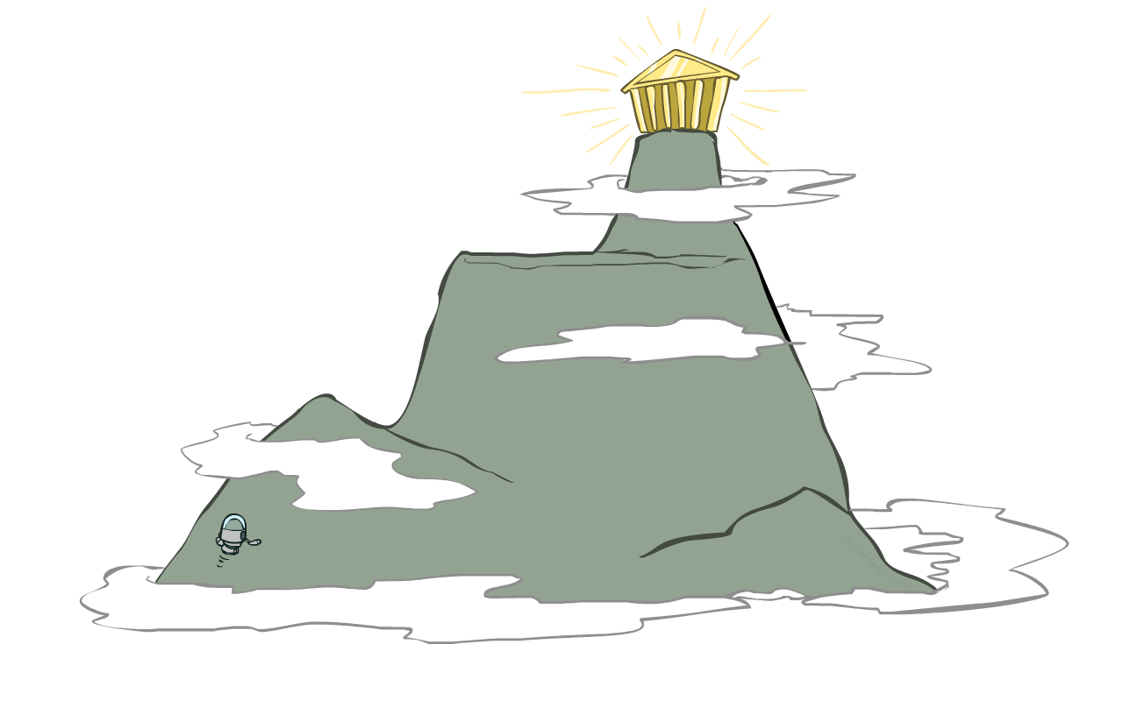
Local Search
Simple, general idea:
Start wherever
Repeat: move to the best neighboring state
If no neighbors better than current, quit
Neighbors = small perturbations of w
Properties
Plateaus and local optima
How to escape plateaus and find a good local optimum?
How to deal with very large parameter vectors? E.g.,

Slide 8
Loss Functions
Measurement: Zero-One Loss
Zero-one Loss isn’t smooth:
Small changes to weight vector have no effect on loss.
Hard to optimize.
Note: $w^{T}f\left(x\right)=w⋅f(x)$, both notations are common.

Slide 9
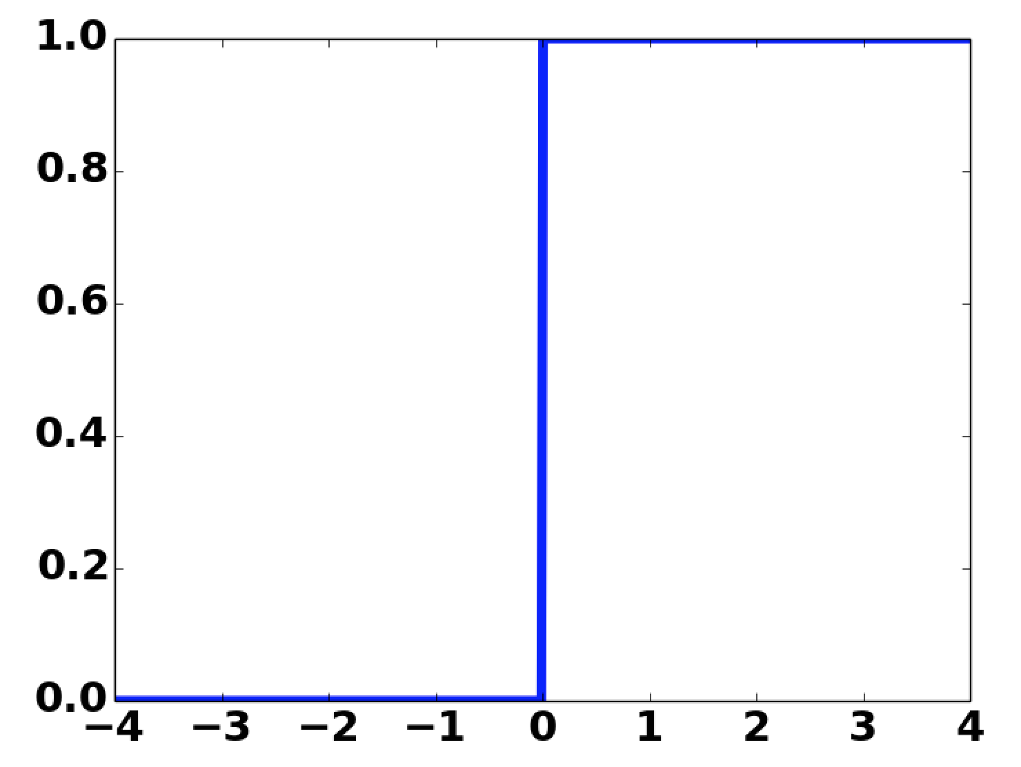
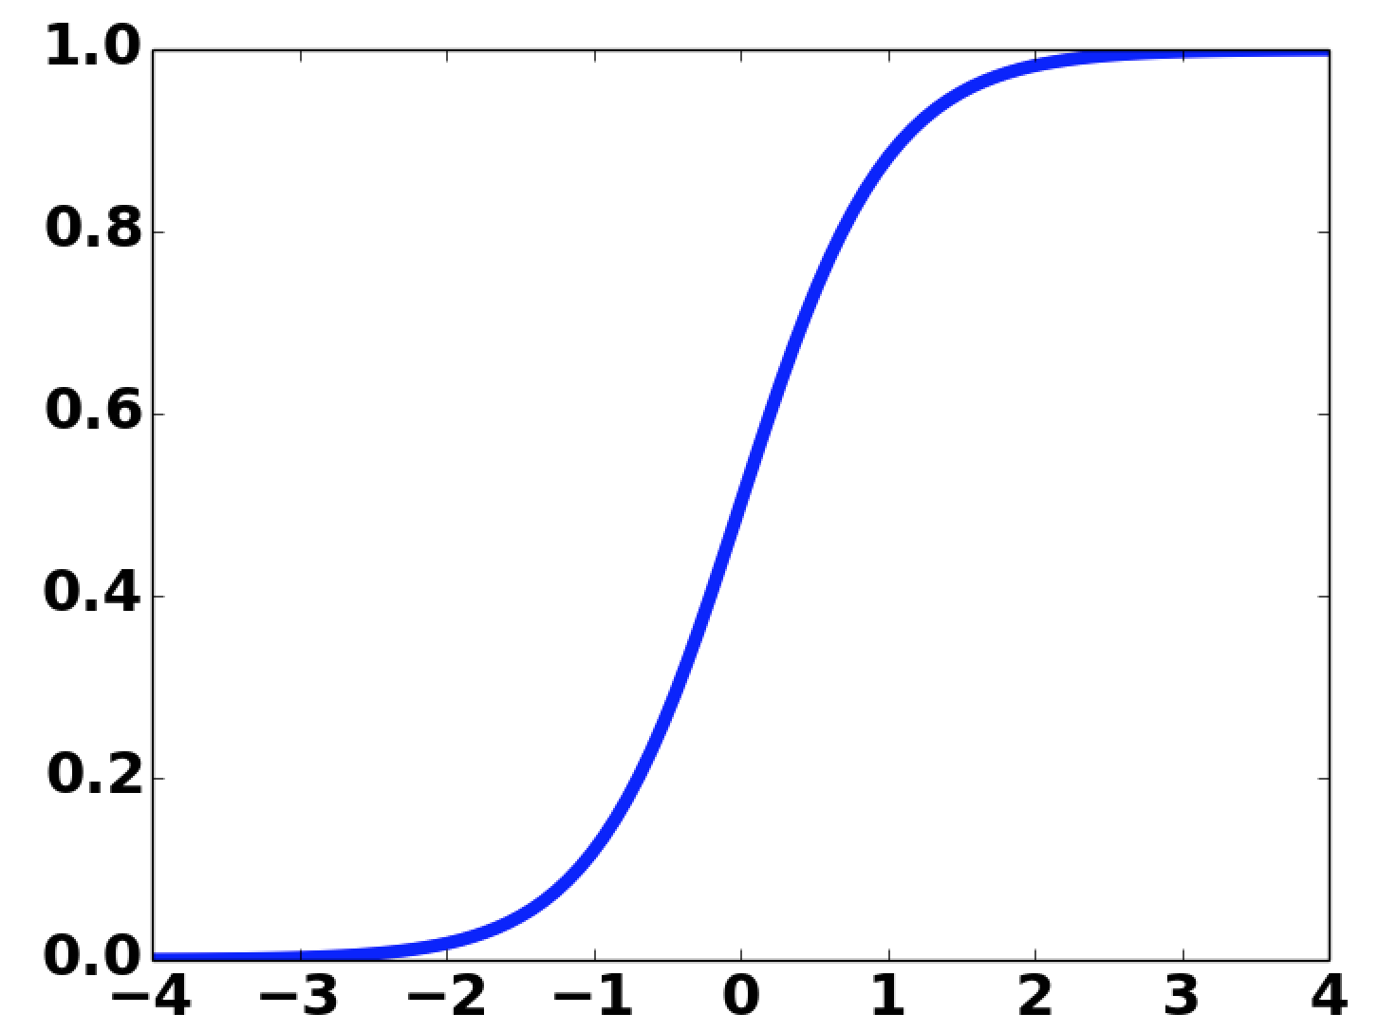
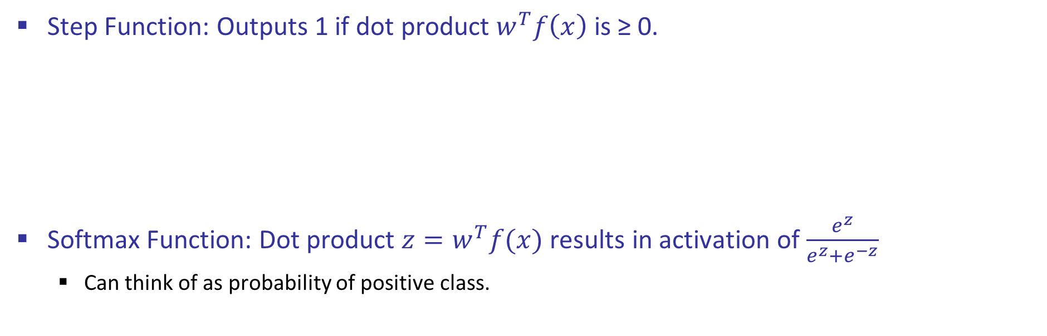
Softmax Activation Function
Step Function: Outputs 1 if dot product $w^{T}f\left(x\right)$ is ≥ 0.
Softmax Function: Dot product $z=w^{T}f(x)$ results in activation of $\frac{e^{z}}{e^{z}+e^{−z}}$
Can think of as probability of positive class.
w₁
f₁
Σ
w₂
≥0?
f₂
w₃
f₃
w₁
f₁
Σ
w₂
f₂
w₃
f₃

Slide 10
Two-Layer Neural Network w/Softmax
w₁₁
Σ
w₂₁
>0?
w₃₁
w₁
f₁
w₁₂
Σ
Σ
w₂₂
>0?
w₂
f₂
w₃₂
w₃
f₃
w₁₃
Σ
w₂₃
>0?
w₃₃

Slide 11
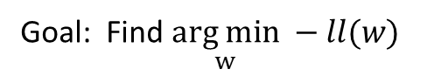
Softmax
Score for y=1: Score for y=-1:
Probability of label:
Objective:
Log:
Goal: Find $\underset{w}{arg min} −ll(w)$

Slide 12
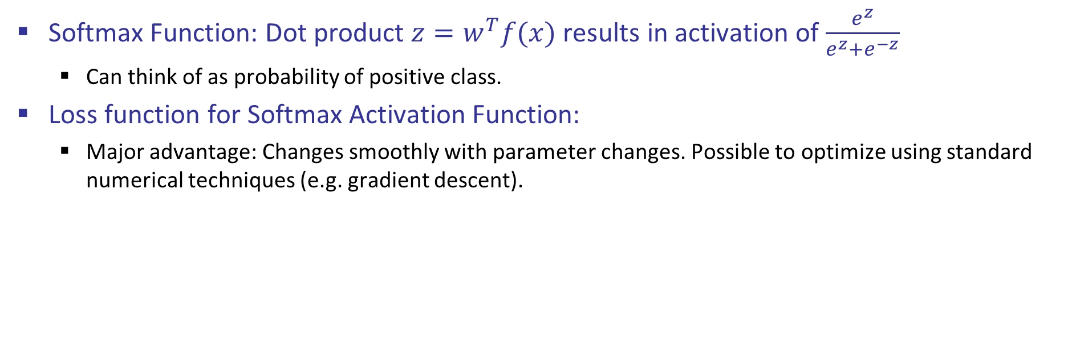
Loss Under Softmax Activation Function
Softmax Function: Dot product $z=w^{T}f(x)$ results in activation of $\frac{e^{z}}{e^{z}+e^{−z}}$
Can think of as probability of positive class.
Loss function for Softmax Activation Function:
Major advantage: Changes smoothly with parameter changes. Possible to optimize using standard numerical techniques (e.g. gradient descent).

Slide 13
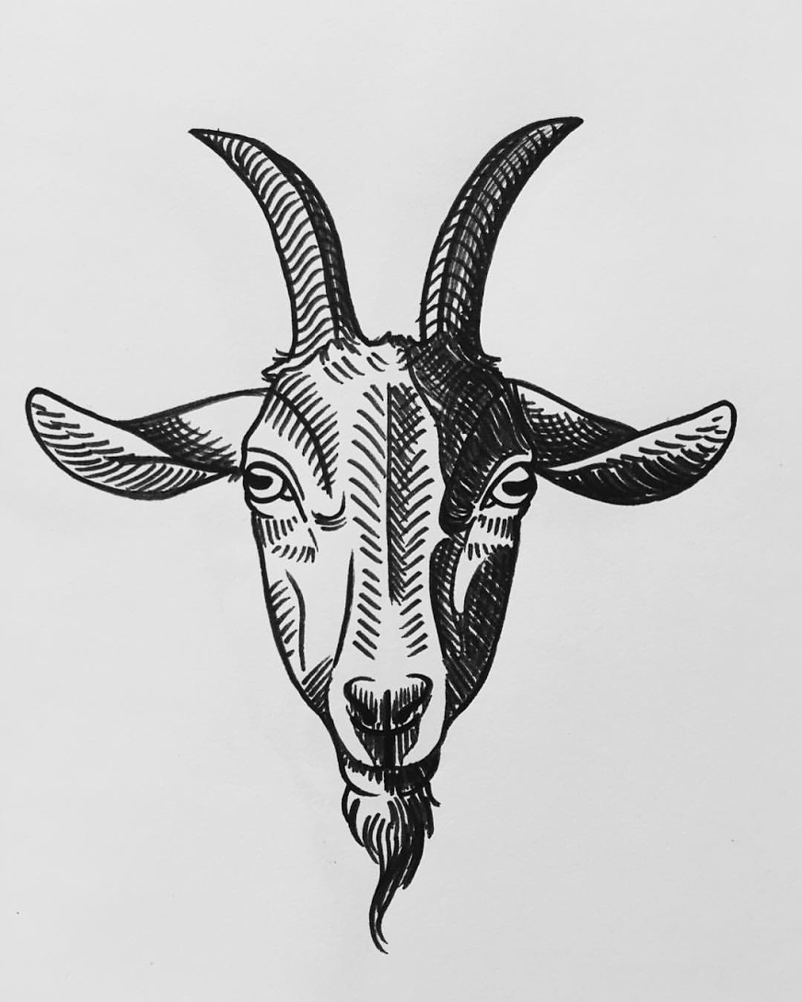
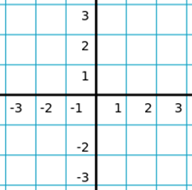
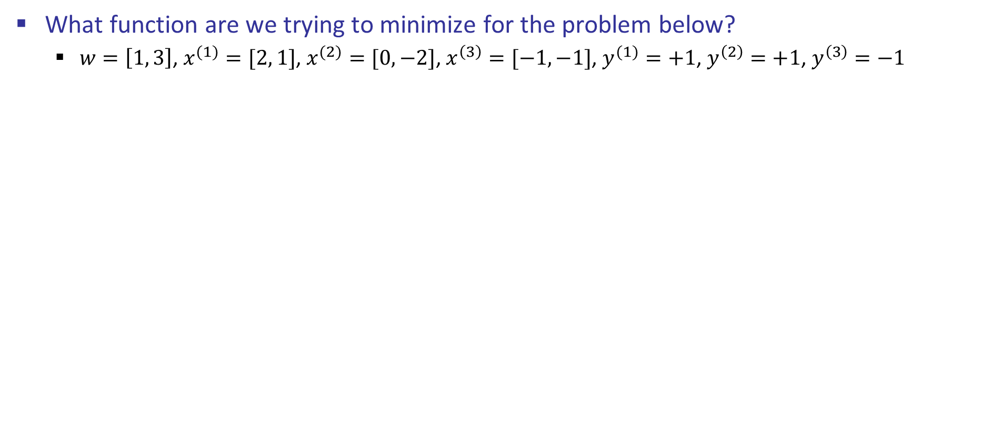
Function Optimization
What function are we trying to minimize for the problem below?
$w=\left[1, 3\right]$, $x^{(1)}=[2, 1]$, $x^{(2)}=[0, −2]$, $x^{\left(3\right)}=[−1,−1]$, $y^{(1)}=+1$, $y^{\left(2\right)}=+1$, $y^{\left(3\right)}=−1$
+
-
+

Slide 14
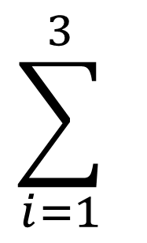
Function Optimization
What function are we trying to minimize for the problem below?
$w=\left[1, 3\right]$, $x^{(1)}=[2, 1]$, $x^{(2)}=[0, −2]$, $x^{\left(3\right)}=[−1,−1]$, $y^{(1)}=+1$, $y^{\left(2\right)}=+1$, $y^{\left(3\right)}=−1$
$$w^{T}x^{\left(1\right)}=2w_{1}+w_{2}→p\left(y=y^{\left(1\right)}\right)=\log\left(\frac{e^{2w_{1}+w_{2}}}{e^{2w_{1}+w_{2}}+e^{−2w_{1}−w_{2}}}\right)$$
$$\sum_{i=1}^{3}{ }$$
+
$$w^{T}x^{\left(2\right)}=−2w_{2}→p\left(y=y^{\left(2\right)}\right)=\log\left(\frac{e^{−2w_{2}}}{e^{−2w_{2}}+e^{2w_{2}}}\right)$$
-
$$w^{T}x^{\left(3\right)}=−w_{1}−w_{2}→p\left(y=y^{\left(3\right)}\right)=\log\left(\frac{e^{w_{1}+w_{2}}}{e^{w_{1}+w_{2}}+e^{−w_{1}−w_{2}}}\right)$$
+
$$−ll\left(w\right)=−\log\left(\frac{e^{2w_{1}+w_{2}}}{e^{2w_{1}+w_{2}}+e^{−2w_{1}−w_{2}}}\right)−\log\left(\frac{e^{−2w_{2}}}{e^{−2w_{2}}+e^{2w_{2}}}\right)−\log\left(\frac{e^{w_{1}+w_{2}}}{e^{w_{1}+w_{2}}+e^{−w_{1}−w_{2}}}\right)$$
Note: current weight vector [1, 3 is irrelevant]

Slide 15
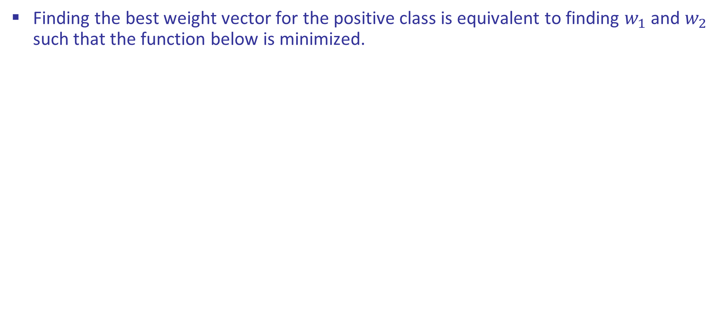
Function Optimization
Finding the best weight vector for the positive class is equivalent to finding $w_{1}$ and $w_{2}$ such that the function below is minimized.
+
$$\min_{w_{1},w_{2}}\left(−\log\left(\frac{e^{2w_{1}+w_{2}}}{e^{2w_{1}+w_{2}}+e^{−2w_{1}−w_{2}}}\right)−\log\left(\frac{e^{−2w_{2}}}{e^{−2w_{2}}+e^{2w_{2}}}\right)−\log\left(\frac{e^{w_{1}+w_{2}}}{e^{w_{1}+w_{2}}+e^{−w_{1}−w_{2}}}\right)\right)$$
-
+

Slide 16
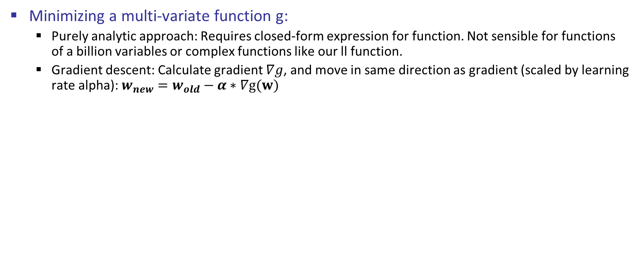
Function Optimization
Minimizing a multi-variate function g:
Purely analytic approach: Requires closed-form expression for function. Not sensible for functions of a billion variables or complex functions like our ll function.
Gradient descent: Calculate gradient $∇g$, and move in same direction as gradient (scaled by learning rate alpha): $w_{new}=w_{old}−α∗∇g(w)$
+
-
+
$$\min_{w_{1},w_{2}}\left(−\log\left(\frac{e^{2w_{1}+w_{2}}}{e^{2w_{1}+w_{2}}+e^{−2w_{1}−w_{2}}}\right)−\log\left(\frac{e^{−2w_{2}}}{e^{−2w_{2}}+e^{2w_{2}}}\right)−\log\left(\frac{e^{w_{1}+w_{2}}}{e^{w_{1}+w_{2}}+e^{−w_{1}−w_{2}}}\right)\right)$$
Notes:
-log( e^(2*x+y) / (e^(2*x+y) + e^(-2*x+y))) -log(e^(-w2)/(e^-w2+e^w2)) -log(e^(w1+w2)/(e^(w1+w2)+e^(-w1-w2)))
-log( e^(2*x+y) / (e^(2*x+y) + e^(-2*x-y)) -log(e^(-y)/(e^-y+e^y)) -log(e^(x+y)/(e^(x+y)+e^(-x-y))

Slide 17
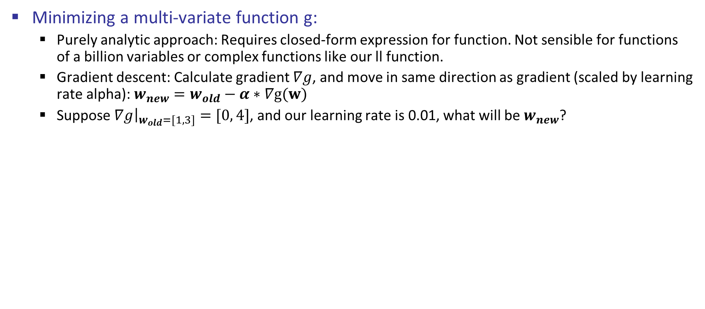
Function Optimization
Minimizing a multi-variate function g:
Purely analytic approach: Requires closed-form expression for function. Not sensible for functions of a billion variables or complex functions like our ll function.
Gradient descent: Calculate gradient $∇g$, and move in same direction as gradient (scaled by learning rate alpha): $w_{new}=w_{old}−α∗∇g(w)$
Suppose ${\left.∇g\right|}_{w_{old}=[1, 3]}=[0, 4]$, and our learning rate is 0.01, what will be $w_{new}$?
+
-
+
$$\min_{w_{1},w_{2}}\left(−\log\left(\frac{e^{2w_{1}+w_{2}}}{e^{2w_{1}+w_{2}}+e^{−2w_{1}−w_{2}}}\right)−\log\left(\frac{e^{−2w_{2}}}{e^{−2w_{2}}+e^{2w_{2}}}\right)−\log\left(\frac{e^{w_{1}+w_{2}}}{e^{w_{1}+w_{2}}+e^{−w_{1}−w_{2}}}\right)\right)$$
Notes:
-log( e^(2*x+y) / (e^(2*x+y) + e^(-2*x+y))) -log(e^(-w2)/(e^-w2+e^w2)) -log(e^(w1+w2)/(e^(w1+w2)+e^(-w1-w2)))
-log( e^(2*x+y) / (e^(2*x+y) + e^(-2*x-y)) -log(e^(-y)/(e^-y+e^y)) -log(e^(x+y)/(e^(x+y)+e^(-x-y))

Slide 18
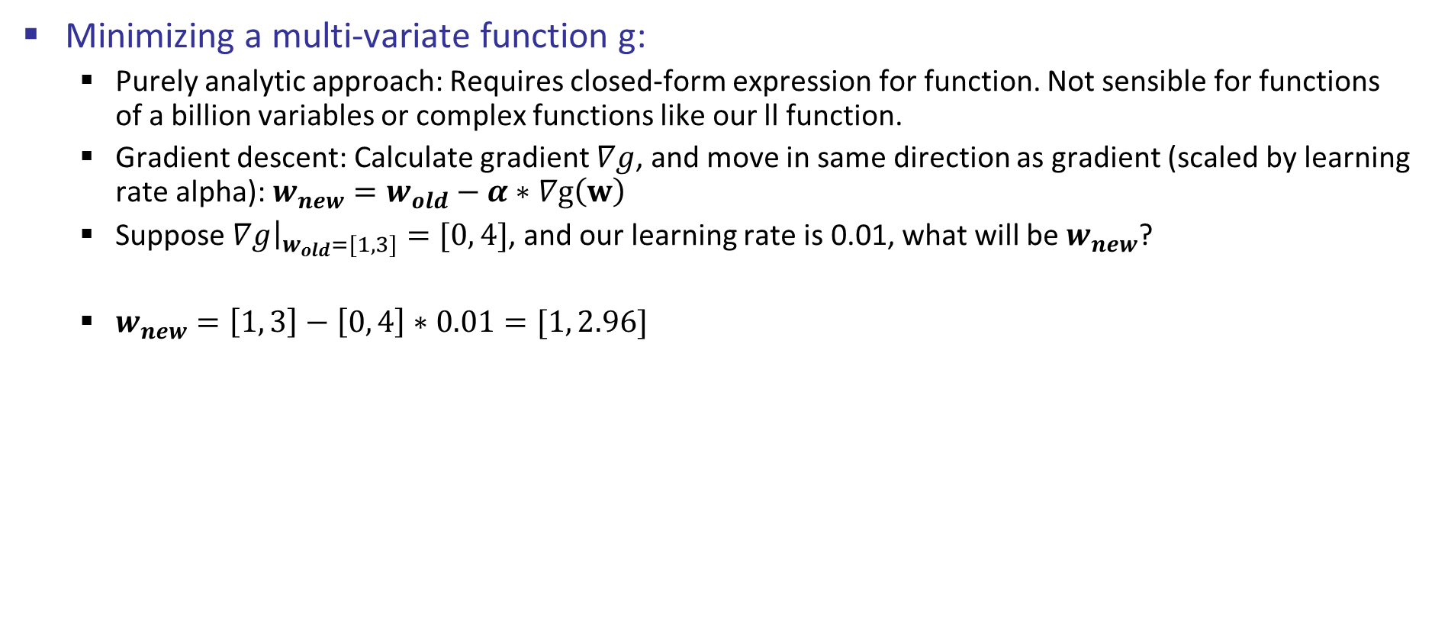
Function Optimization
Minimizing a multi-variate function g:
Purely analytic approach: Requires closed-form expression for function. Not sensible for functions of a billion variables or complex functions like our ll function.
Gradient descent: Calculate gradient $∇g$, and move in same direction as gradient (scaled by learning rate alpha): $w_{new}=w_{old}−α∗∇g\left(w\right)$
Suppose ${\left.∇g\right|}_{w_{old}=[1, 3]}=[0, 4]$, and our learning rate is 0.01, what will be $w_{new}$?
$w_{new}=\left[1, 3\right]−\left[0, 4\right]∗0.01=[1, 2.96]$
+
-
+
$$\min_{w_{1},w_{2}}\left(−\log\left(\frac{e^{2w_{1}+w_{2}}}{e^{2w_{1}+w_{2}}+e^{−2w_{1}−w_{2}}}\right)−\log\left(\frac{e^{−2w_{2}}}{e^{−2w_{2}}+e^{2w_{2}}}\right)−\log\left(\frac{e^{w_{1}+w_{2}}}{e^{w_{1}+w_{2}}+e^{−w_{1}−w_{2}}}\right)\right)$$
Notes:
-log( e^(2*x+y) / (e^(2*x+y) + e^(-2*x+y))) -log(e^(-w2)/(e^-w2+e^w2)) -log(e^(w1+w2)/(e^(w1+w2)+e^(-w1-w2)))
-log( e^(2*x+y) / (e^(2*x+y) + e^(-2*x-y)) -log(e^(-y)/(e^-y+e^y)) -log(e^(x+y)/(e^(x+y)+e^(-x-y))

Slide 19
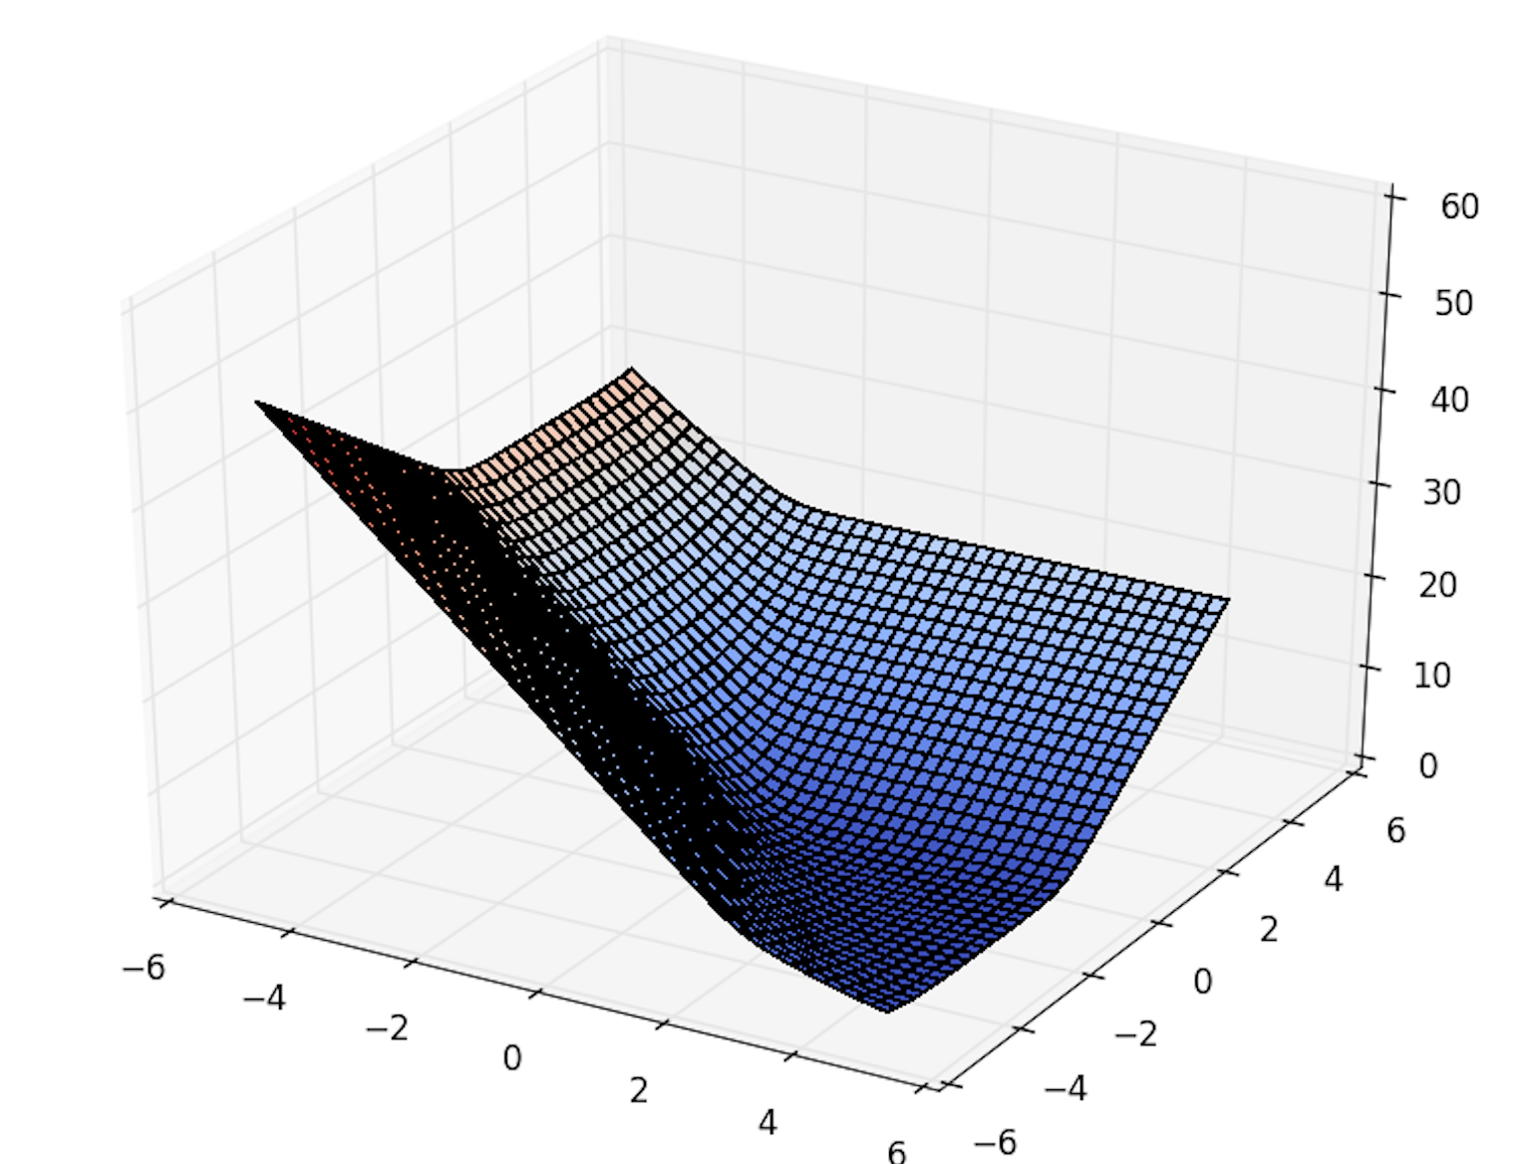
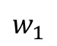
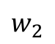
Gradient Descent Visualization
We can plot ll(w).
+
-
$$w_{2}$$
+
$$w_{1}$$
$$\min_{w_{1},w_{2}}\left(−\log\left(\frac{e^{2w_{1}+w_{2}}}{e^{2w_{1}+w_{2}}+e^{−2w_{1}−w_{2}}}\right)−\log\left(\frac{e^{−2w_{2}}}{e^{−2w_{2}}+e^{2w_{2}}}\right)−\log\left(\frac{e^{w_{1}+w_{2}}}{e^{w_{1}+w_{2}}+e^{−w_{1}−w_{2}}}\right)\right)$$
Notes:
-log( e^(2*x+y) / (e^(2*x+y) + e^(-2*x+y))) -log(e^(-w2)/(e^-w2+e^w2)) -log(e^(w1+w2)/(e^(w1+w2)+e^(-w1-w2)))
-log( e^(2*x+y) / (e^(2*x+y) + e^(-2*x-y)) -log(e^(-y)/(e^-y+e^y)) -log(e^(x+y)/(e^(x+y)+e^(-x-y))

Slide 20
Gradient Descent Visualization
We can plot ll(w).
+
-
$$w_{2}$$
+
$$w_{1}$$
$$\min_{w_{1},w_{2}}\left(−\log\left(\frac{e^{2w_{1}+w_{2}}}{e^{2w_{1}+w_{2}}+e^{−2w_{1}−w_{2}}}\right)−\log\left(\frac{e^{−2w_{2}}}{e^{−2w_{2}}+e^{2w_{2}}}\right)−\log\left(\frac{e^{w_{1}+w_{2}}}{e^{w_{1}+w_{2}}+e^{−w_{1}−w_{2}}}\right)\right)$$
Notes:
-log( e^(2*x+y) / (e^(2*x+y) + e^(-2*x+y))) -log(e^(-w2)/(e^-w2+e^w2)) -log(e^(w1+w2)/(e^(w1+w2)+e^(-w1-w2)))
-log( e^(2*x+y) / (e^(2*x+y) + e^(-2*x-y)) -log(e^(-y)/(e^-y+e^y)) -log(e^(x+y)/(e^(x+y)+e^(-x-y))

Slide 21
Gradient Descent Visualization
We can plot ll(w).
+
-
$$w_{2}$$
+
$$w_{1}$$
$$\min_{w_{1},w_{2}}\left(−\log\left(\frac{e^{2w_{1}+w_{2}}}{e^{2w_{1}+w_{2}}+e^{−2w_{1}−w_{2}}}\right)−\log\left(\frac{e^{−2w_{2}}}{e^{−2w_{2}}+e^{2w_{2}}}\right)−\log\left(\frac{e^{w_{1}+w_{2}}}{e^{w_{1}+w_{2}}+e^{−w_{1}−w_{2}}}\right)\right)$$
Notes:
-log( e^(2*x+y) / (e^(2*x+y) + e^(-2*x+y))) -log(e^(-w2)/(e^-w2+e^w2)) -log(e^(w1+w2)/(e^(w1+w2)+e^(-w1-w2)))
-log( e^(2*x+y) / (e^(2*x+y) + e^(-2*x-y)) -log(e^(-y)/(e^-y+e^y)) -log(e^(x+y)/(e^(x+y)+e^(-x-y))

Slide 22
Gradient Descent Visualization
We can plot ll(w).
+
-
$$w_{2}$$
+
$$w_{1}$$
$$\min_{w_{1},w_{2}}\left(−\log\left(\frac{e^{2w_{1}+w_{2}}}{e^{2w_{1}+w_{2}}+e^{−2w_{1}−w_{2}}}\right)−\log\left(\frac{e^{−2w_{2}}}{e^{−2w_{2}}+e^{2w_{2}}}\right)−\log\left(\frac{e^{w_{1}+w_{2}}}{e^{w_{1}+w_{2}}+e^{−w_{1}−w_{2}}}\right)\right)$$
Notes:
-log( e^(2*x+y) / (e^(2*x+y) + e^(-2*x+y))) -log(e^(-w2)/(e^-w2+e^w2)) -log(e^(w1+w2)/(e^(w1+w2)+e^(-w1-w2)))
-log( e^(2*x+y) / (e^(2*x+y) + e^(-2*x-y)) -log(e^(-y)/(e^-y+e^y)) -log(e^(x+y)/(e^(x+y)+e^(-x-y))

Slide 23
Gradient Descent Visualization
We can plot ll(w).
+
-
$$w_{2}$$
+
$$w_{1}$$
$$\min_{w_{1},w_{2}}\left(−\log\left(\frac{e^{2w_{1}+w_{2}}}{e^{2w_{1}+w_{2}}+e^{−2w_{1}−w_{2}}}\right)−\log\left(\frac{e^{−2w_{2}}}{e^{−2w_{2}}+e^{2w_{2}}}\right)−\log\left(\frac{e^{w_{1}+w_{2}}}{e^{w_{1}+w_{2}}+e^{−w_{1}−w_{2}}}\right)\right)$$
Notes:
-log( e^(2*x+y) / (e^(2*x+y) + e^(-2*x+y))) -log(e^(-w2)/(e^-w2+e^w2)) -log(e^(w1+w2)/(e^(w1+w2)+e^(-w1-w2)))
-log( e^(2*x+y) / (e^(2*x+y) + e^(-2*x-y)) -log(e^(-y)/(e^-y+e^y)) -log(e^(x+y)/(e^(x+y)+e^(-x-y))

Slide 24
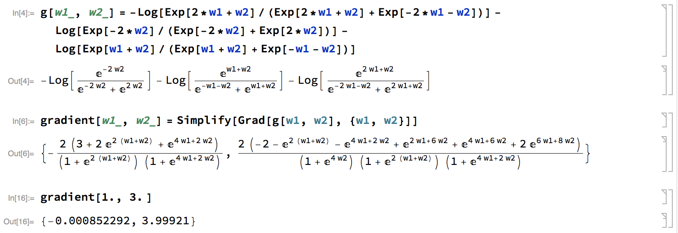
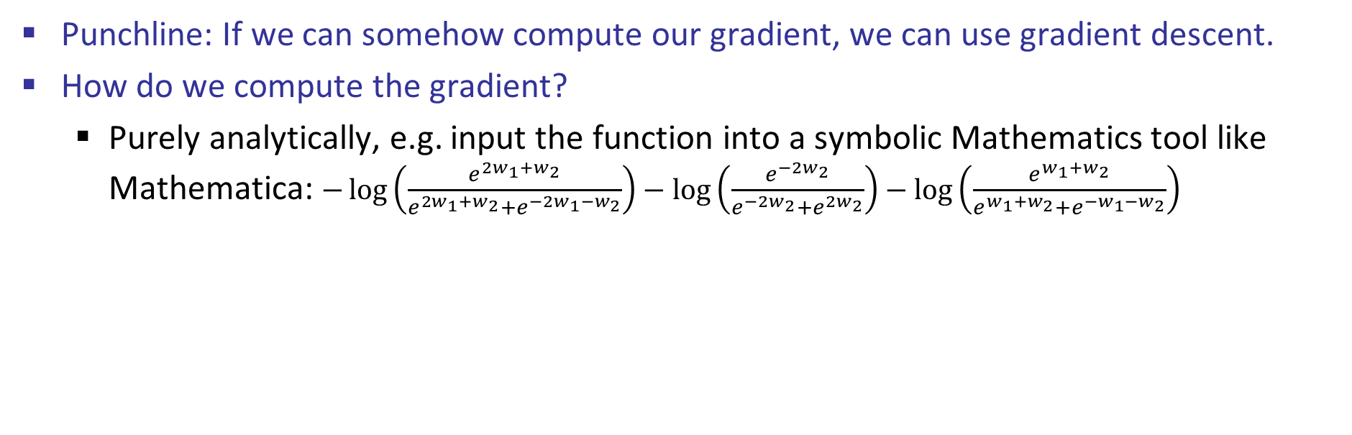
Gradient Descent
Punchline: If we can somehow compute our gradient, we can use gradient descent.
How do we compute the gradient?
Purely analytically, e.g. input the function into a symbolic Mathematics tool like Mathematica: $−\log\left(\frac{e^{2w_{1}+w_{2}}}{e^{2w_{1}+w_{2}}+e^{−2w_{1}−w_{2}}}\right)−\log\left(\frac{e^{−2w_{2}}}{e^{−2w_{2}}+e^{2w_{2}}}\right)−\log\left(\frac{e^{w_{1}+w_{2}}}{e^{w_{1}+w_{2}}+e^{−w_{1}−w_{2}}}\right)$
(In the real world, this wouldn’t be hand-typed!)

Slide 25
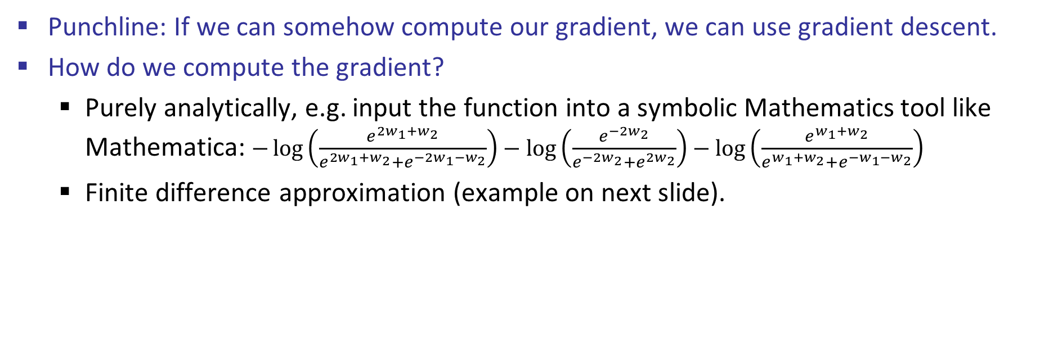
Gradient Descent
Punchline: If we can somehow compute our gradient, we can use gradient descent.
How do we compute the gradient?
Purely analytically, e.g. input the function into a symbolic Mathematics tool like Mathematica: $−\log\left(\frac{e^{2w_{1}+w_{2}}}{e^{2w_{1}+w_{2}}+e^{−2w_{1}−w_{2}}}\right)−\log\left(\frac{e^{−2w_{2}}}{e^{−2w_{2}}+e^{2w_{2}}}\right)−\log\left(\frac{e^{w_{1}+w_{2}}}{e^{w_{1}+w_{2}}+e^{−w_{1}−w_{2}}}\right)$
Finite difference approximation (example on next slide).

Slide 26
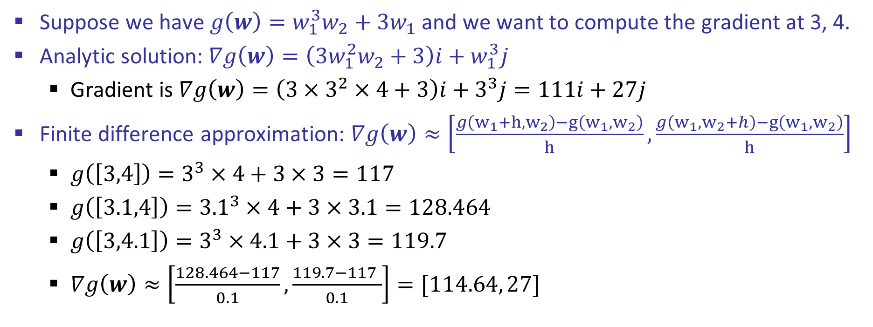
Finite Difference Approximation
Suppose we have $g\left(w\right)=w_{1}^{3}w_{2}+3w_{1}$ and we want to compute the gradient at 3, 4.
Analytic solution: $∇g\left(w\right)=\left(3w_{1}^{2}w_{2}+3\right)i+w_{1}^{3}j$
Gradient is $∇g\left(w\right)=\left(3×3^{2}×4+3\right)i+3^{3}j=111i+27j$
Finite difference approximation: $∇g\left(w\right)≈\left[\frac{g\left(w_{1}+h,w_{2}\right)−g\left(w_{1},w_{2}\right)}{h}, \frac{g\left(w_{1},w_{2}+h\right)−g\left(w_{1},w_{2}\right)}{h}\right]$
$g\left(\left[3,4\right]\right)=3^{3}×4+3×3=117$
$g\left(\left[3.1,4\right]\right)={3.1}^{3}×4+3×3.1=128.464$
$g\left(\left[3,4.1\right]\right)=3^{3}×4.1+3×3=119.7$
$∇g\left(w\right)≈\left[\frac{128.464−117}{0.1}, \frac{119.7−117 }{0.1}\right]=[114.64, 27]$

Slide 27
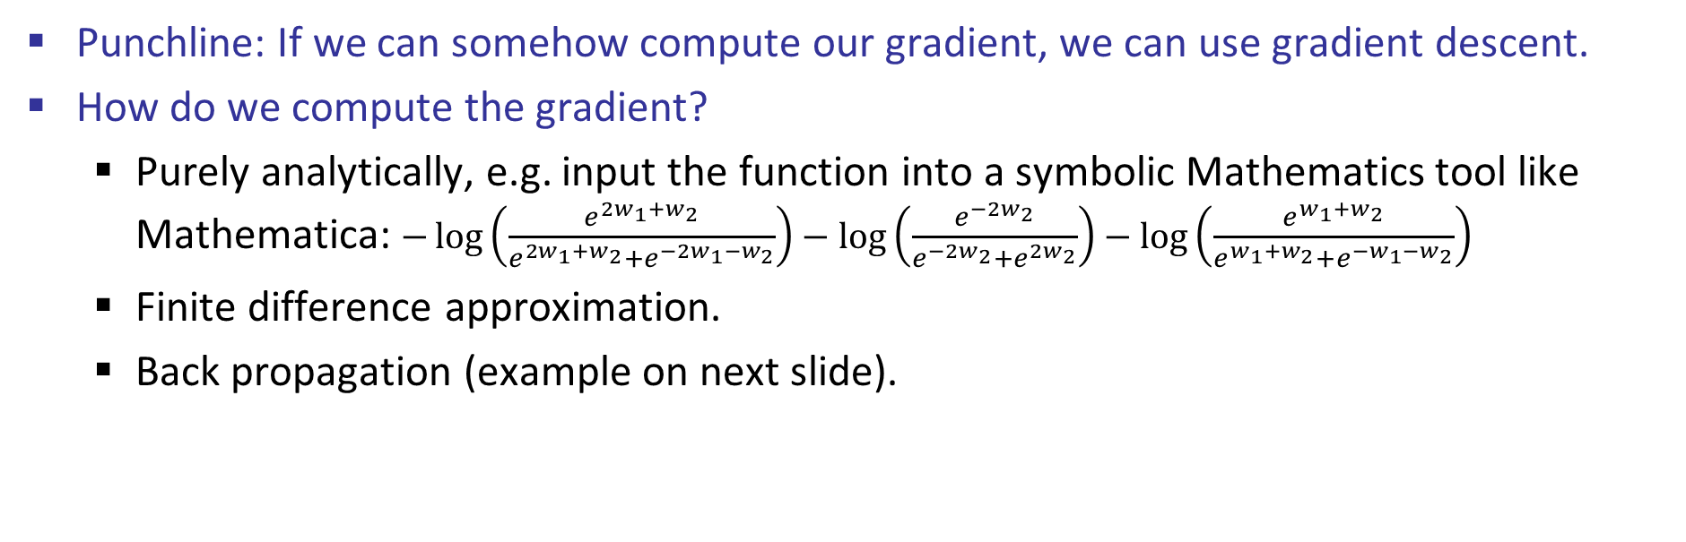
Gradient Descent
Punchline: If we can somehow compute our gradient, we can use gradient descent.
How do we compute the gradient?
Purely analytically, e.g. input the function into a symbolic Mathematics tool like Mathematica: $−\log\left(\frac{e^{2w_{1}+w_{2}}}{e^{2w_{1}+w_{2}}+e^{−2w_{1}−w_{2}}}\right)−\log\left(\frac{e^{−2w_{2}}}{e^{−2w_{2}}+e^{2w_{2}}}\right)−\log\left(\frac{e^{w_{1}+w_{2}}}{e^{w_{1}+w_{2}}+e^{−w_{1}−w_{2}}}\right)$
Finite difference approximation.
Back propagation (example on next slide).

Slide 28
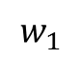
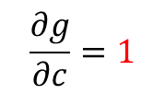
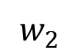
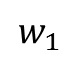
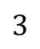
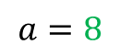
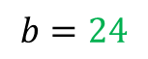
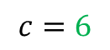
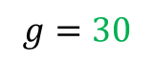
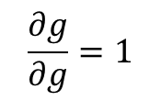

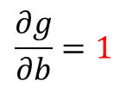

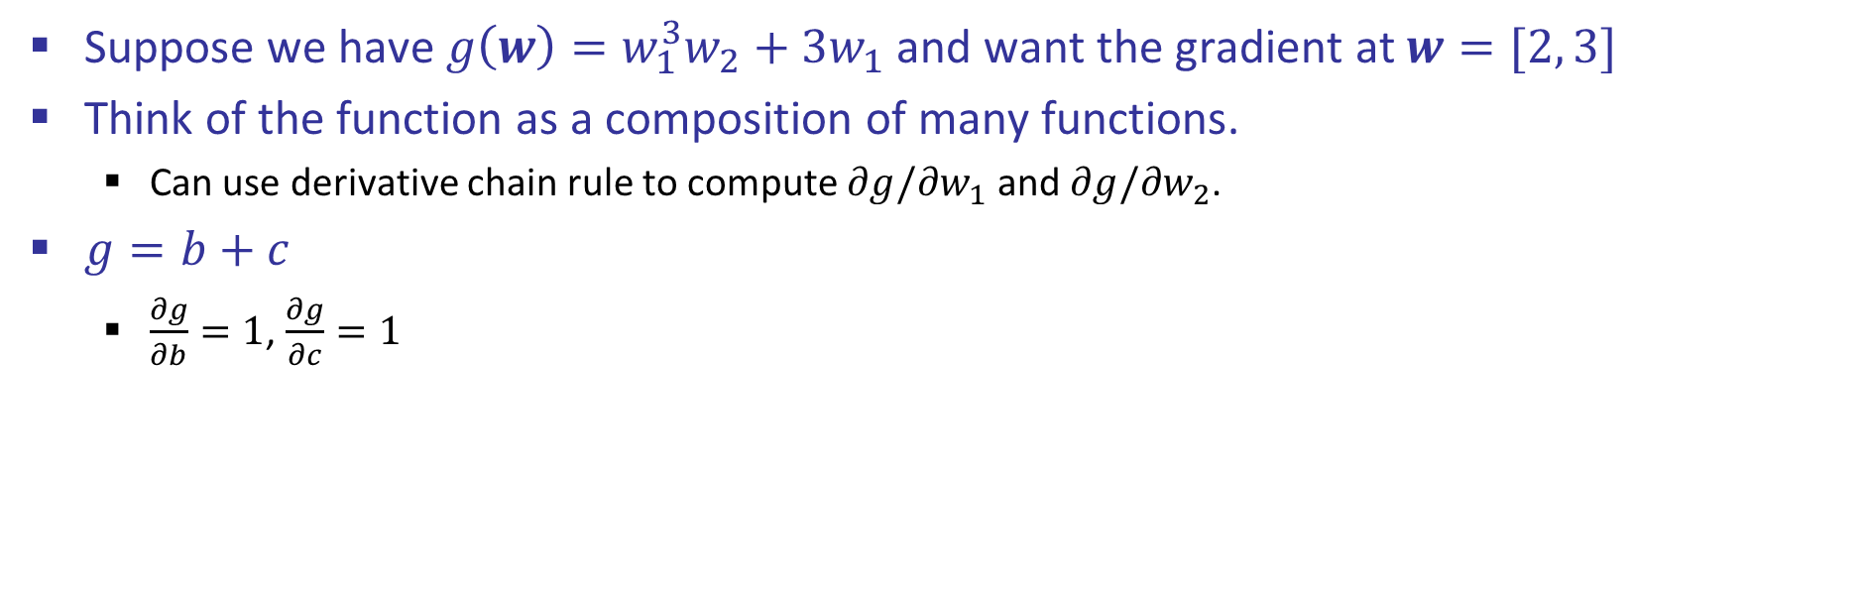




Back Propagation: $g\left(w\right)=w_{1}^{3}w_{2}+3w_{1}$
Suppose we have $g\left(w\right)=w_{1}^{3}w_{2}+3w_{1}$ and want the gradient at $w=[2, 3]$
Think of the function as a composition of many functions.
Can use derivative chain rule to compute $∂g/∂w_{1}$ and $∂g/∂w_{2}$.
$g=b+c$
$\frac{∂g}{∂b}=1$, $\frac{∂g}{∂c}=1$
2
$∎^{3}$
$$a=8$$
$$w_{1}$$
$×$
$$b=24$$
3
$$\frac{∂g}{∂b}=1$$
$$w_{2}$$
$$g=30$$
$+$
$$1$$
$$3$$
$×$
$$c=6$$
$$w_{1}$$
2
$$\frac{∂g}{∂c}=1$$
$$\frac{∂g}{∂g}=1$$

Slide 29
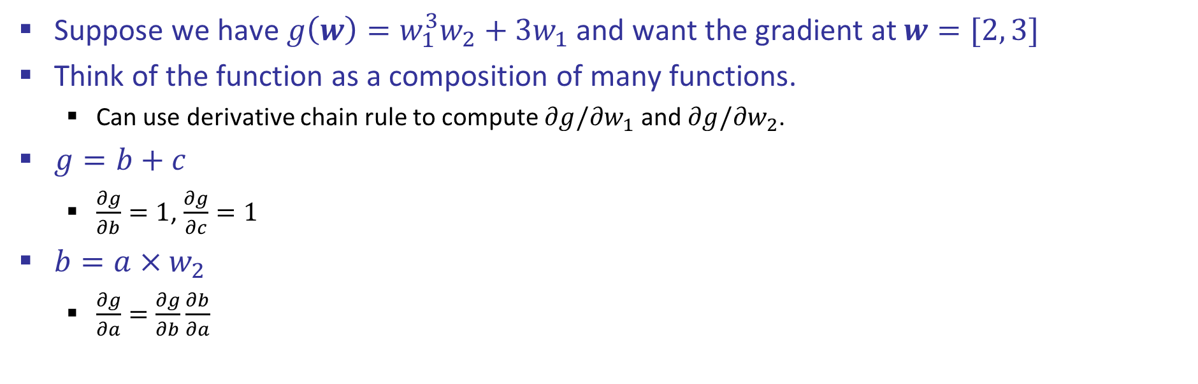
Back Propagation: $g\left(w\right)=w_{1}^{3}w_{2}+3w_{1}$
Suppose we have $g\left(w\right)=w_{1}^{3}w_{2}+3w_{1}$ and want the gradient at $w=[2, 3]$
Think of the function as a composition of many functions.
Can use derivative chain rule to compute $∂g/∂w_{1}$ and $∂g/∂w_{2}$.
$g=b+c$
$\frac{∂g}{∂b}=1$, $\frac{∂g}{∂c}=1$
$b=a×w_{2}$
$\frac{∂g}{∂a}=\frac{∂g}{∂b}\frac{∂b}{∂a}$
2
$∎^{3}$
$$a=8$$
$$w_{1}$$
$×$
$$b=24$$
3
$$\frac{∂g}{∂b}=1$$
$$w_{2}$$
$$g=30$$
$+$
$$1$$
$$3$$
$×$
$$c=6$$
$$w_{1}$$
2
$$\frac{∂g}{∂c}=1$$
$$\frac{∂g}{∂g}=1$$

Slide 30

Back Propagation: $g\left(w\right)=w_{1}^{3}w_{2}+3w_{1}$
Suppose we have $g\left(w\right)=w_{1}^{3}w_{2}+3w_{1}$ and want the gradient at $w=[2, 3]$
Think of the function as a composition of many functions.
Can use derivative chain rule to compute $∂g/∂w_{1}$ and $∂g/∂w_{2}$.
$g=b+c$
$\frac{∂g}{∂b}=1$, $\frac{∂g}{∂c}=1$
$b=a×w_{2}$
$\frac{∂g}{∂a}=\frac{∂g}{∂b}\frac{∂b}{∂a}=?????$
2
$∎^{3}$
$$a=8$$
$$w_{1}$$
$×$
$$b=24$$
3
$$\frac{∂g}{∂b}=1$$
$$w_{2}$$
$$g=30$$
$+$
$$1$$
$$3$$
$×$
$$c=6$$
$$w_{1}$$
2
$$\frac{∂g}{∂c}=1$$
$$\frac{∂g}{∂g}=1$$

Slide 31
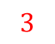
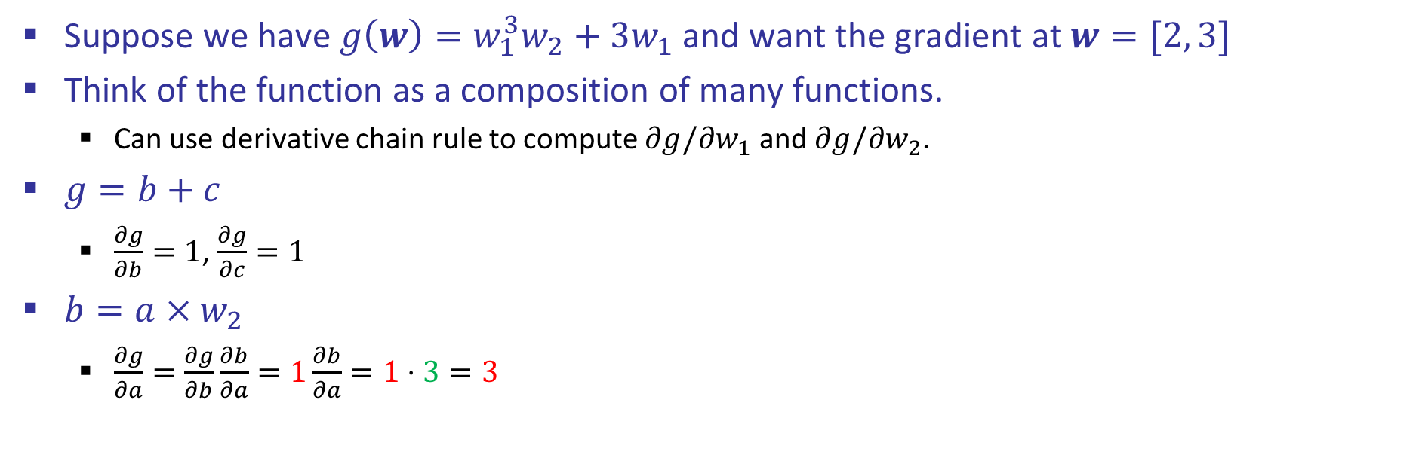
Back Propagation: $g\left(w\right)=w_{1}^{3}w_{2}+3w_{1}$
Suppose we have $g\left(w\right)=w_{1}^{3}w_{2}+3w_{1}$ and want the gradient at $w=[2, 3]$
Think of the function as a composition of many functions.
Can use derivative chain rule to compute $∂g/∂w_{1}$ and $∂g/∂w_{2}$.
$g=b+c$
$\frac{∂g}{∂b}=1$, $\frac{∂g}{∂c}=1$
$b=a×w_{2}$
$\frac{∂g}{∂a}=\frac{∂g}{∂b}\frac{∂b}{∂a}=1\frac{∂b}{∂a}=1⋅3=3$
2
$∎^{3}$
$$a=8$$
$$w_{1}$$
$$3$$
$×$
$$b=24$$
3
$$\frac{∂g}{∂b}=1$$
$$w_{2}$$
$$g=30$$
$+$
$$1$$
$$3$$
$×$
$$c=6$$
$$w_{1}$$
2
$$\frac{∂g}{∂c}=1$$
$$\frac{∂g}{∂g}=1$$

Slide 32
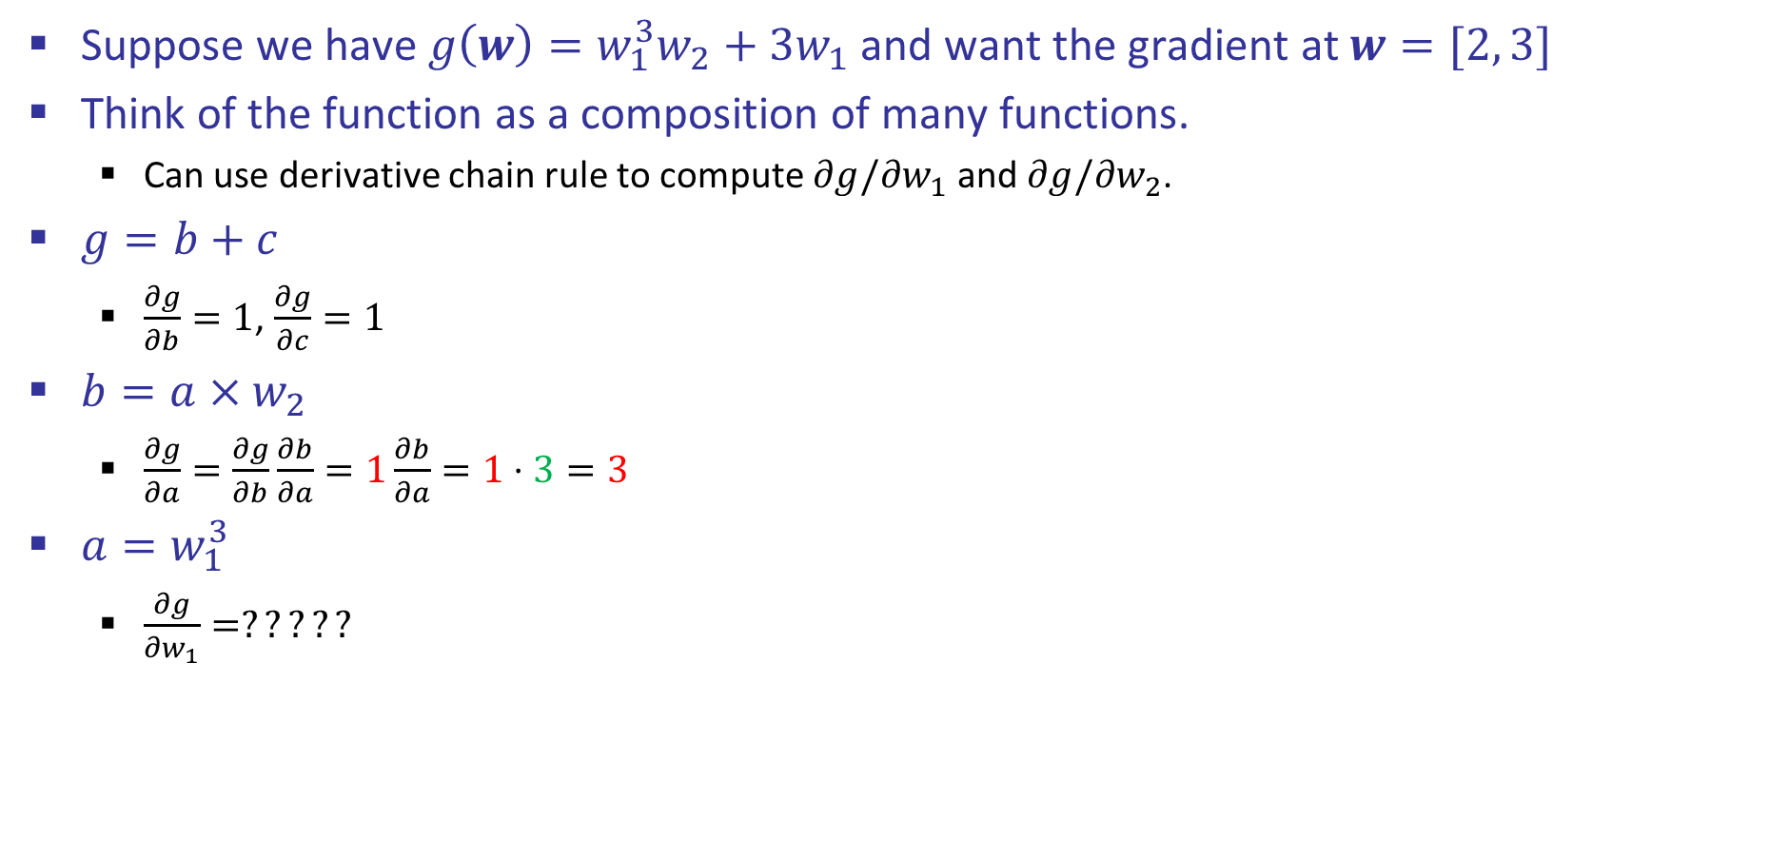
Back Propagation: $g\left(w\right)=w_{1}^{3}w_{2}+3w_{1}$
Suppose we have $g\left(w\right)=w_{1}^{3}w_{2}+3w_{1}$ and want the gradient at $w=[2, 3]$
Think of the function as a composition of many functions.
Can use derivative chain rule to compute $∂g/∂w_{1}$ and $∂g/∂w_{2}$.
$g=b+c$
$\frac{∂g}{∂b}=1$, $\frac{∂g}{∂c}=1$
$b=a×w_{2}$
$\frac{∂g}{∂a}=\frac{∂g}{∂b}\frac{∂b}{∂a}=1\frac{∂b}{∂a}=1⋅3=3$
$a=w_{1}^{3}$
$\frac{∂g}{∂w_{1}}=?????$
2
$∎^{3}$
$$a=8$$
$$w_{1}$$
$$3$$
$×$
$$b=24$$
3
$$\frac{∂g}{∂b}=1$$
$$w_{2}$$
$$g=30$$
$+$
$$1$$
$$3$$
$×$
$$c=6$$
$$w_{1}$$
2
$$\frac{∂g}{∂c}=1$$
$$\frac{∂g}{∂g}=1$$

Slide 33
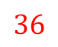
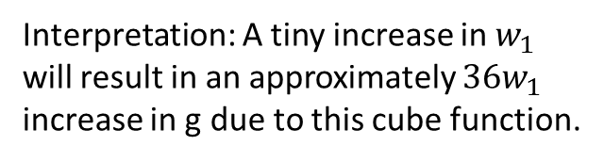
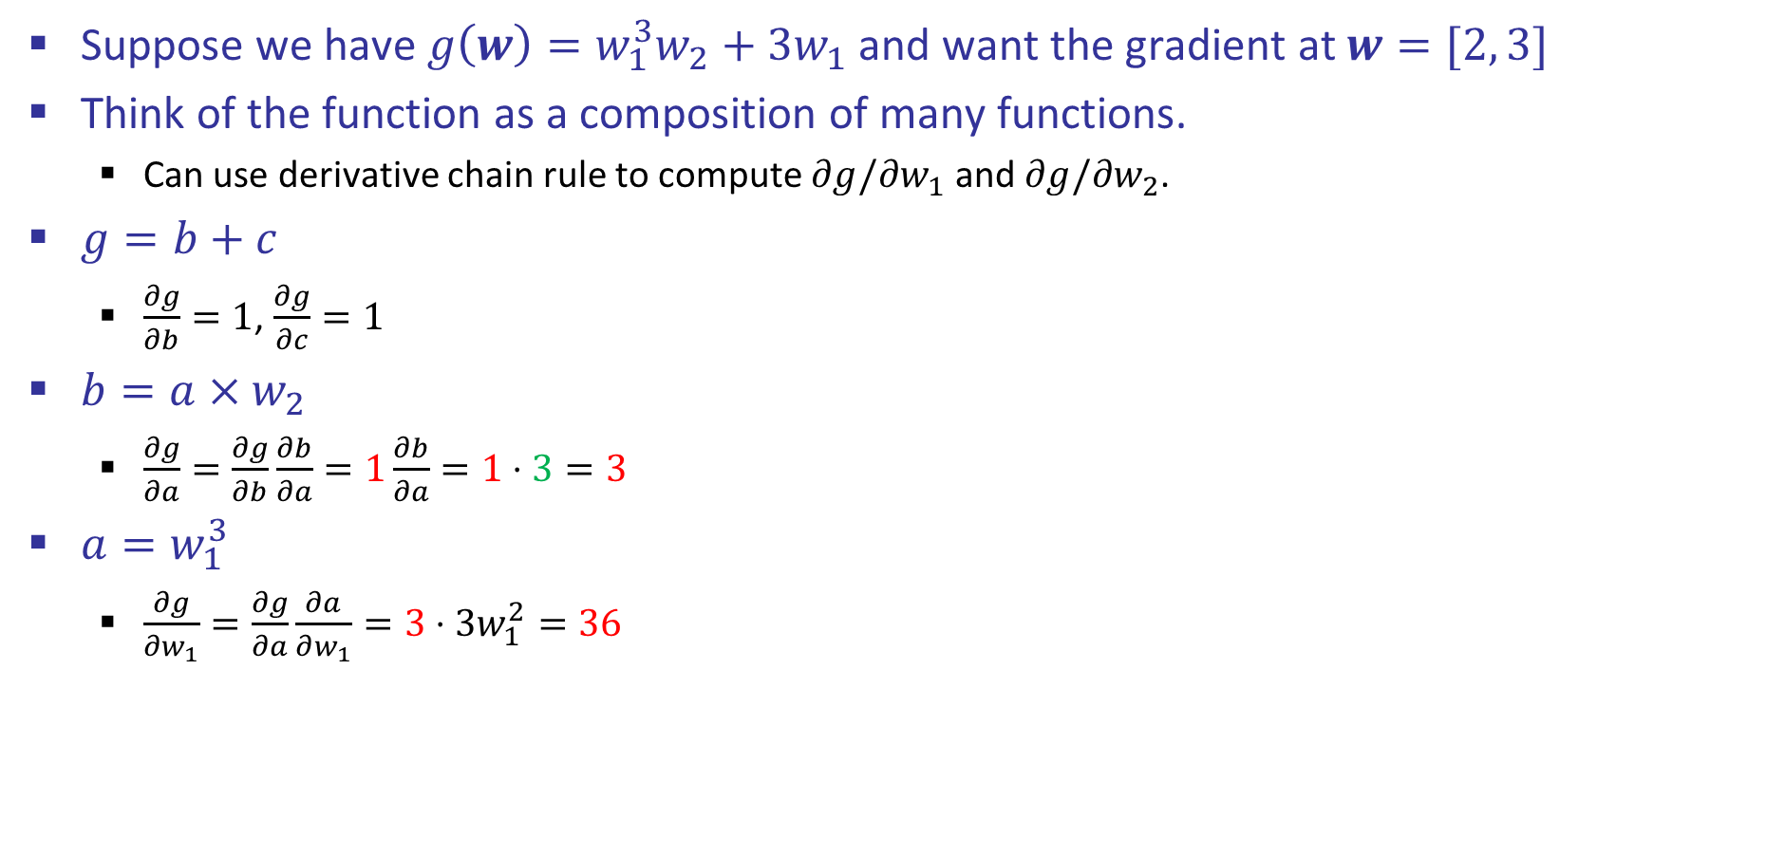
Back Propagation: $g\left(w\right)=w_{1}^{3}w_{2}+3w_{1}$
Suppose we have $g\left(w\right)=w_{1}^{3}w_{2}+3w_{1}$ and want the gradient at $w=[2, 3]$
Think of the function as a composition of many functions.
Can use derivative chain rule to compute $∂g/∂w_{1}$ and $∂g/∂w_{2}$.
$g=b+c$
$\frac{∂g}{∂b}=1$, $\frac{∂g}{∂c}=1$
$b=a×w_{2}$
$\frac{∂g}{∂a}=\frac{∂g}{∂b}\frac{∂b}{∂a}=1\frac{∂b}{∂a}=1⋅3=3$
$a=w_{1}^{3}$
$\frac{∂g}{∂w_{1}}=\frac{∂g}{∂a}\frac{∂a}{∂w_{1}}=3⋅3w_{1}^{2}=36$
2
$∎^{3}$
$$a=8$$
$$w_{1}$$
$$36$$
$$3$$
$×$
$$b=24$$
3
$$\frac{∂g}{∂b}=1$$
$$w_{2}$$
$$g=30$$
$+$
$$1$$
$$3$$
$×$
$$c=6$$
$$w_{1}$$
2
$$\frac{∂g}{∂c}=1$$
$$\frac{∂g}{∂g}=1$$
Interpretation: A tiny increase in $w_{1}$ will result in an approximately $36w_{1}$ increase in g due to this cube function.

Slide 34

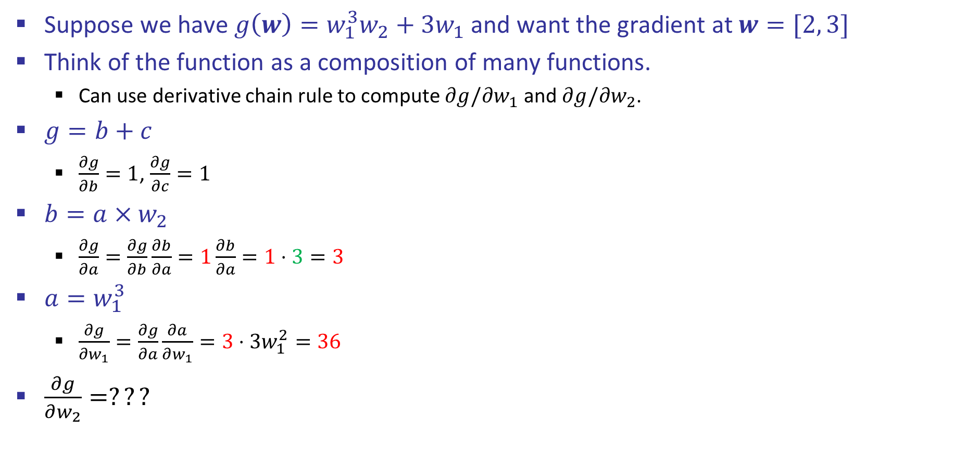
Back Propagation: $g\left(w\right)=w_{1}^{3}w_{2}+3w_{1}$
Suppose we have $g\left(w\right)=w_{1}^{3}w_{2}+3w_{1}$ and want the gradient at $w=[2, 3]$
Think of the function as a composition of many functions.
Can use derivative chain rule to compute $∂g/∂w_{1}$ and $∂g/∂w_{2}$.
$g=b+c$
$\frac{∂g}{∂b}=1$, $\frac{∂g}{∂c}=1$
$b=a×w_{2}$
$\frac{∂g}{∂a}=\frac{∂g}{∂b}\frac{∂b}{∂a}=1\frac{∂b}{∂a}=1⋅3=3$
$a=w_{1}^{3}$
$\frac{∂g}{∂w_{1}}=\frac{∂g}{∂a}\frac{∂a}{∂w_{1}}=3⋅3w_{1}^{2}=36$
$\frac{∂g}{∂w_{2}}=???$
2
$∎^{3}$
$$a=8$$
$$w_{1}$$
$$36$$
$$3$$
$×$
$$b=24$$
3
$$\frac{∂g}{∂b}=1$$
$$w_{2}$$
$$g=30$$
$+$
$$1$$
$$3$$
$×$
$$c=6$$
$$w_{1}$$
2
$$\frac{∂g}{∂c}=1$$
$$\frac{∂g}{∂g}=1$$
Hint: $b=a×3$ may be useful.

Slide 35
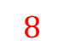
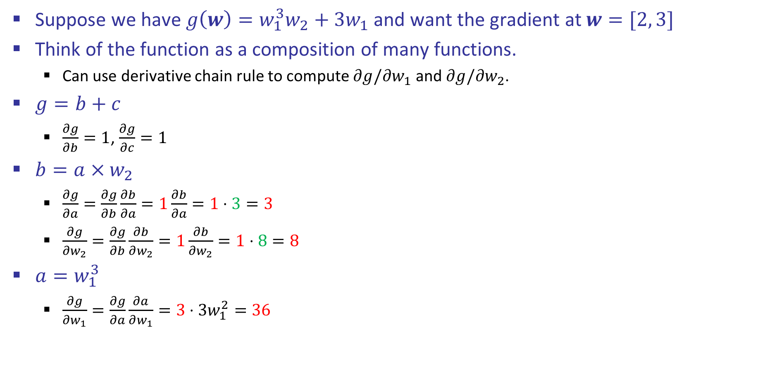
Back Propagation: $g\left(w\right)=w_{1}^{3}w_{2}+3w_{1}$
Suppose we have $g\left(w\right)=w_{1}^{3}w_{2}+3w_{1}$ and want the gradient at $w=[2, 3]$
Think of the function as a composition of many functions.
Can use derivative chain rule to compute $∂g/∂w_{1}$ and $∂g/∂w_{2}$.
$g=b+c$
$\frac{∂g}{∂b}=1$, $\frac{∂g}{∂c}=1$
$b=a×w_{2}$
$\frac{∂g}{∂a}=\frac{∂g}{∂b}\frac{∂b}{∂a}=1\frac{∂b}{∂a}=1⋅3=3$
$\frac{∂g}{∂w_{2}}=\frac{∂g}{∂b}\frac{∂b}{∂w_{2}}=1\frac{∂b}{∂w_{2}}=1⋅8=8$
$a=w_{1}^{3}$
$\frac{∂g}{∂w_{1}}=\frac{∂g}{∂a}\frac{∂a}{∂w_{1}}=3⋅3w_{1}^{2}=36$
2
$∎^{3}$
$$a=8$$
$$w_{1}$$
$$36$$
$$3$$
$×$
$$b=24$$
3
$$\frac{∂g}{∂b}=1$$
$$w_{2}$$
$$g=30$$
$$8$$
$+$
$$1$$
$$3$$
$×$
$$c=6$$
$$w_{1}$$
2
$$\frac{∂g}{∂c}=1$$
$$\frac{∂g}{∂g}=1$$

Slide 36
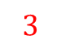
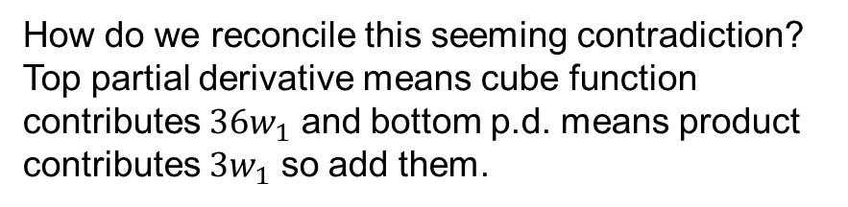

Back Propagation: $g\left(w\right)=w_{1}^{3}w_{2}+3w_{1}$
Suppose we have $g\left(w\right)=w_{1}^{3}w_{2}+3w_{1}$ and want the gradient at $w=[2, 3]$
Think of the function as a composition of many functions, use chain rule.
$g=b+c$
$\frac{∂g}{∂b}=1$, $\frac{∂g}{∂c}=1$
$b=a×w_{2}$
$\frac{∂g}{∂a}=\frac{∂g}{∂b}\frac{∂b}{∂a}=1\frac{∂b}{∂a}=1⋅3=3$
$\frac{∂g}{∂w_{2}}=\frac{∂g}{∂b}\frac{∂b}{∂w_{2}}=1\frac{∂b}{∂w_{2}}=1⋅8=8$
$a=w_{1}^{3}$
$\frac{∂g}{∂w_{1}}=\frac{∂g}{∂a}\frac{∂a}{∂w_{1}}=3⋅3w_{1}^{2}=36$
$c=3w_{1}$
$\frac{∂g}{∂w_{1}}=\frac{∂g}{∂c}\frac{∂c}{∂w_{1}}=1⋅3=3$
2
$∎^{3}$
$$a=8$$
$$w_{1}$$
$$36$$
$$3$$
$×$
$$b=24$$
3
$$\frac{∂g}{∂b}=1$$
$$w_{2}$$
$$g=30$$
$$8$$
$+$
$$1$$
$$3$$
$×$
$$c=6$$
$$w_{1}$$
2
$$3$$
$$\frac{∂g}{∂c}=1$$
$$\frac{∂g}{∂g}=1$$
How do we reconcile this seeming contradiction?
Top partial derivative means cube function contributes $36w_{1}$ and bottom p.d. means product contributes $3w_{1}$ so add them.

Slide 37

Back Propagation: $g\left(w\right)=w_{1}^{3}w_{2}+3w_{1}$
Suppose we have $g\left(w\right)=w_{1}^{3}w_{2}+3w_{1}$ and want the gradient at $w=[2, 3]$
Think of the function as a composition of many functions, use chain rule.
$g=b+c$
$\frac{∂g}{∂b}=1$, $\frac{∂g}{∂c}=1$
$b=a×w_{2}$
$\frac{∂g}{∂a}=\frac{∂g}{∂b}\frac{∂b}{∂a}=1\frac{∂b}{∂a}=1⋅3=3$
$\frac{∂g}{∂w_{2}}=\frac{∂g}{∂b}\frac{∂b}{∂w_{2}}=1\frac{∂b}{∂w_{2}}=1⋅8=8$
$a=w_{1}^{3}$
$\frac{∂g}{∂w_{1}}=\frac{∂g}{∂a}\frac{∂a}{∂w_{1}}=3⋅3w_{1}^{2}=36$
$c=3w_{1}$
$\frac{∂g}{∂w_{1}}=\frac{∂g}{∂c}\frac{∂c}{∂w_{1}}=1⋅3=3$
2
$∎^{3}$
$$a=8$$
$$w_{1}$$
$$36$$
$$3$$
$×$
$$b=24$$
3
$$\frac{∂g}{∂b}=1$$
$$w_{2}$$
$$g=30$$
$$8$$
$+$
$$1$$
$$3$$
$×$
$$c=6$$
$$w_{1}$$
2
$$3$$
$$\frac{∂g}{∂c}=1$$
$$\frac{∂g}{∂g}=1$$
$$∇g=\left[\frac{∂g}{∂w_{1}},\frac{∂g}{∂w_{2}}\right]=[39, 8]$$

Slide 38

Gradient Descent
Punchline: If we can somehow compute our gradient, we can use gradient descent.
How do we compute the gradient?
Purely analytically.
Gives exact symbolic answer. Infeasible for functions of lots of parameters or input values.
Finite difference approximation.
Gives approximation, very easy to implement.
Runtime for ll: $O\left(NM\right)$, where N is the number of parameters, and M is number of data points.
Back propagation.
Gives exact answer, difficult to implement.
Runtime for ll: $O(NM)$

Slide 39


BP Implementation: forward/backward API
Graph (or Net) object. (Rough psuedo code)

Slide 40


BP Implementation: forward/backward API
x
z
*
y
(x,y,z are scalars)

Slide 41
Optimizations and Modifications
Mini-batching and Stochastic Gradient Descent
Multiclass
Activation Functions
Dropout
For more: See Spring 2016 Deep Learning Lecture 2
Covers a briefly some additional modern techniques.
Notes:
Linear, no good.
Zero-centered: Better gradient descent behavior.
ReLU: Avoid plateaus
Leaky ReLU: Avoid pleataus even more

Slide 42

Stochastic Gradient Descent
Idea: Rather than looking at the gradient of the loss function on ALL data points, consider loss for only ONE data point.
Update Algorithm:
Repeat for each data point:
Compute $∇ll_{i}(w)$, where $ll_{i}\left(w\right)=\log{p\left(y=y^{\left(i\right)} \right|}f\left(x^{\left(i\right)};w\right)$
$w=w−α∗∇ll_{i}\left(w\right)$
Typically will iterate over all data points before reusing any data points.
See 189 for why this works.

Slide 43

Mini-batches
Idea: Rather than looking at the gradient of the loss function on ALL data points, consider loss for only some random subset.
Update Algorithm:
For each batch of data points $B_{j}$:
Compute $∇ll_{j}(w)$, where $ll_{j}\left(w\right)=\sum_{i∈B_{j}}{\log{p\left(y=y^{\left(i\right)} \right|}f\left(x^{\left(i\right)};w\right)}$
$w=w−α∗∇ll_{i}(w)$
Example: $B_{1}=\left\{1, …, k\right\}, B_{2}=\left\{k+1, …, 2k\right\},…$
More generally: Pick a set of random data points for each batch – why?
Typically will iterate over all batches before returning reusing any data.

Slide 44
Optimizations and Modifications
Mini-batching and Stochastic Gradient Descent
Multiclass
Activation Functions
Dropout
For more: See Spring 2016 Deep Learning Lecture 2
Covers briefly some additional techniques.
Notes:
Linear, no good.
Zero-centered: Better gradient descent behavior.
ReLU: Avoid plateaus
Leaky ReLU: Avoid pleataus even more

Slide 45
Multi-class Softmax
3-class softmax – classes A, B, C
3 weight vectors:
Probability of label A: (similar for B, C)
Objective:
Log:

Slide 46
Optimizations and Modifications
Mini-batching and Stochastic Gradient Descent
Multiclass
Activation Functions
Dropout
For more: See Spring 2016 Deep Learning Lecture 2
Covers briefly some additional techniques.
Notes:
Linear, no good.
Zero-centered: Better gradient descent behavior.
ReLU: Avoid plateaus
Leaky ReLU: Avoid pleataus even more

Slide 47
Two-Layer Neural Network
w₁₁
Σ
w₂₁
>0?
w₃₁
w₁
f₁
w₁₂
Σ
Σ
w₂₂
>0?
w₂
f₂
w₃₂
w₃
f₃
w₁₃
Σ
w₂₃
>0?
w₃₃

Slide 48
Two-Layer Neural Network
w₁₁
Σ
w₂₁
>0?
w₃₁
w₁
f₁
w₁₂
Σ
Σ
w₂₂
>0?
w₂
f₂
w₃₂
w₃
f₃
w₁₃
Σ
w₂₃
>0?
Intermediate layers are often something else, e.g. tanh.
w₃₃

Slide 49
N-Layer Neural Network
Σ
Σ
Σ
>0?
>0?
>0?
…
f₁
Σ
Σ
Σ
Σ
>0?
>0?
>0?
f₂
…
f₃
Σ
Σ
Σ
>0?
>0?
…
>0?

Slide 50





Activation Functions
Sigmoid
Leaky ReLU
max(0.1x, x)
tanh tanh(x)
ReLU max(0,x)

Slide 51
Optimizations and Modifications
Mini-batching and Stochastic Gradient Descent
Multiclass
Activation Functions
Dropout
For more: See Spring 2016 Deep Learning Lecture 2
Covers (very briefly) some additional techniques: initialization, batch normalization, gradient descent with momentum.
May discuss a few of these during the last lecture.
189 goes into MUCH more detail.
Reminder: Come in with your linear algebra really solid!
Notes:
Linear, no good.
Zero-centered: Better gradient descent behavior.
ReLU: Avoid plateaus
Leaky ReLU: Avoid pleataus even more

Slide 52

Regularization: Dropout
“randomly set some neurons to zero in the forward pass”
[Srivastava et al., 2014]

Slide 53

Waaaait a second…
How could this possibly be a good idea?

Slide 54
Waaaait a second…
How could this possibly be a good idea?
Forces the network to have a redundant representation.
has an ear
X
has a tail
is furry
X
cat
score
has claws
X
mischievous
look

Slide 55
Neural Network Playground
Let’s see some Neural Networks in action: (Link)
We’ll now know what most (but not all) of the options mean.

Slide 56
Deep Learning Frameworks
TensorFlow
Theano
Torch
CAFFE
Computation Graph Toolkit (CGT)
For more: Adam’s Office Hours (Thursday 11:30 – 12:30)

